Slide 1



School of Computing
Vel Tech Rangarajan Dr. Sagunthala R&D Institute of Science and Technology
Department of Computer Science and Engineering
10211 CS 224 / FULL STA CK APPLICATION DEVELOPMENT (JAVA)
PROJECT REVIEW : MILESTONE PROJECT – 1
Date: 23-03-2026
Automated Quiz Engine with PDF Certification Generation
SDG 4 – Quality Education
Presented By:
V.Mounika – VTU25894 – 23UECS0589
Courses Handling Faculty:
Dr. Hafizur Rahman – Associative professor

Slide 2
INTRODUCTION
1
Background of the problem:
Manual quiz management and certificate generation are time-consuming, error-prone, and difficult to scale in modern digital learning environments.
2
3
Why this project is important:
This project is important because it automates time-consuming tasks like quiz evaluation and
certificate generation, saving effort and reducing errors.
4
5
Real-world relevance:
This system is widely applicable in e-learning platforms, schools, and corporate training
programs where large-scale assessments are required.
Brief overview of the system:
The system conducts automated quizzes, evaluates responses instantly, and stores results
efficiently.
6
7
8
9

Slide 3
PROBLEM STATEMENT
In today’s fast-paced digital world, education and training institutions face significant challenges in efficiently managing assessments and certifications. Traditional quiz and examination processes are often manual, time-consuming, and prone to errors, making it difficult to handle large numbers of participants effectively. Educators and administrators spend considerable time creating quizzes, grading responses, and generating certificates, which slows down the entire evaluation process and limits scalability. Additionally, manual certificate creation lacks standardization and often delays the recognition of learners’ achievements, impacting motivation and trust in the certification process. With the rapid growth of online learning platforms and remote training programs, there is a pressing need for an automated system that can streamline these tasks. Such a system should be capable of creating and delivering quizzes, automatically evaluating answers, and instantly generating personalized certificates in a secure and standardized PDF format.
1
2
3
4
5
6
7
8
9

Slide 4
OBJECTIVES
1
Automate Quiz Creation: Provide an easy-to-use interface for creating and managing
quizzes with various question types.
Instant Evaluation: Automatically assess quiz answers and deliver immediate results to users.
User Progress Tracking: Store and track users’ quiz attempts and scores securely.
PDF Certificate Generation: Automatically generate personalized, professional PDF certificates for users who pass the quiz.
Ensure Scalability: Handle multiple users and quizzes efficiently without performance
loss.
Reduce Administrative Workload: Minimize manual tasks in quiz management, evaluation, and certification issuance.
To design anfd develop a automated quize engine and certification generation using
HTML,CSS,JAVA SCRIPT.
2
4
5
6
7
8
9

Slide 5
PROPOSED SYSTEM
1
Support registration and login for quiz takers and administrators with role-based access
control.
Instantly assess user responses, calculate scores, and securely store results for tracking and reporting.
Automatically generate personalized PDF certificates for users who pass, featuring their
details and verification info.
Ensure a seamless, intuitive interface with data persistence and implement strong security to protect user information and certificates.
2
3
4
5
6
7
8
9

Slide 6

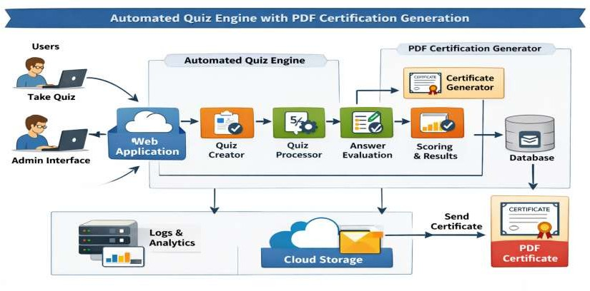
PROPOSED SYSTEM ARCHITECTURE
1
2
3
4
5
6
7
8
9

Slide 7
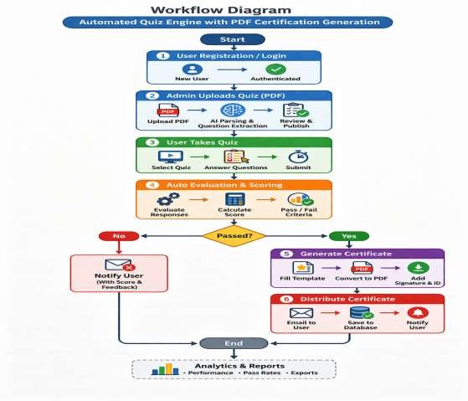
WORKFLOW
Dataflow diagram:
1
2
3
4
5
6
7
8
9

Slide 8
TECHNOLOGIES USED
Frontend:
HTML5
CSS3
Javascript
Backend:
…
Tools:
Visual Studio Code
Notepad
Software Requirements:
Windows
Web Browser
1
2
3
4
5
6
8
9

Slide 9

MODULE DESCRIPTION
1
Module 1: User Management Module :
Handles user registration, authentication, and role-based access control. It manages different user types such as quiz takers and administrators, ensuring secure login and personalized access to features.
Module 2: Quiz Creation and Management Module:
Allows administrators to create, edit, and organize quizzes. Supports multiple question types (e.g., multiple choice, true/false) and categorizes quizzes for easy navigation and dynamic rendering.
Module 2: Quiz Evaluation and Result Module
Automates the evaluation of quiz submissions, calculates scores instantly, and stores the results securely. It also provides feedback to users and maintains detailed records for administrative reporting.
Module 4: Certificate Generation Module
Generates personalized PDF certificates automatically for users who successfully pass quizzes.
2
3
4
5
6
7
8
9

Slide 10

IMPLEMENTATION SCREENSHOTS
1
Login Page:
2
3
4
5
6
7
8
9

Slide 11
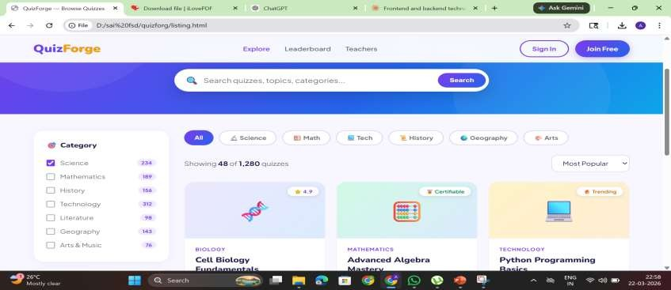
IMPLEMENTATION SCREENSHOTS
Main Page :
1
2
3
4
5
6
7
8(A)
9

Slide 12
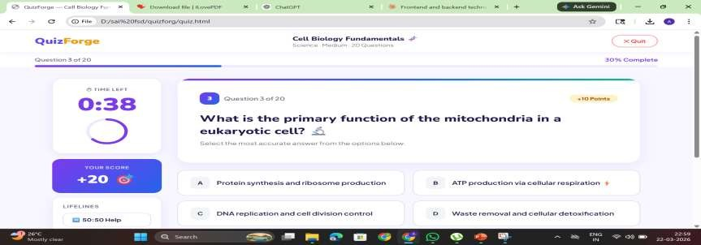
IMPLEMENTATION SCREENSHOTS
Quiz page :
1
2
3
4
5
6
7
8(B)
9

Slide 13
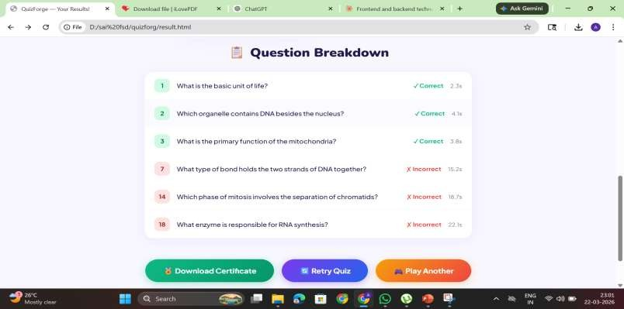
IMPLEMENTATION SCREENSHOTS
1
2
3
4
5
6
7
8(C)
9

Slide 14
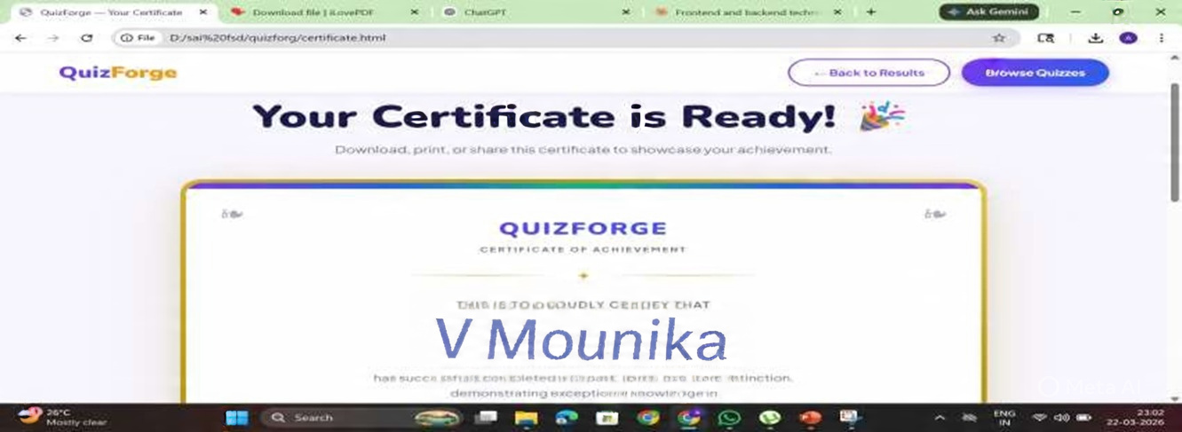
IMPLEMENTATION SCREENSHOTS
Certification view page

Slide 15

ADVANTAGES & LIMITATIONS
1
Advantages:
2
Instant quiz evaluation
Automated PDF certificate generation
Reduces manual workload.
Scaable for many users
3
4
5
Limitations:
6
7
Requires stable internet connection.
Limited offline accessibility.
Dependent on system security.
Initial setup may be complex.
8
9

Slide 16
Thank you

